Slide 1

School of Computer Engineering AND Technology
PROJECT PRESENTATION
By
Niranjan Vinod Patil
SCETBTB305

Slide 2
Area of Project Work - NLP
What is NLP ?
NLP Stands for Natural Language Processing
Human Language – Most diverse & Complex Part, 6500 Languages
Big Data – Structured, Unstructured & Semi-structured textual form
Want to produce significant & actionable insights from this data
Text Mining/Text analytics – deriving meaningful information
NLP – Communicating with NL using AI & Understand Context

Slide 3
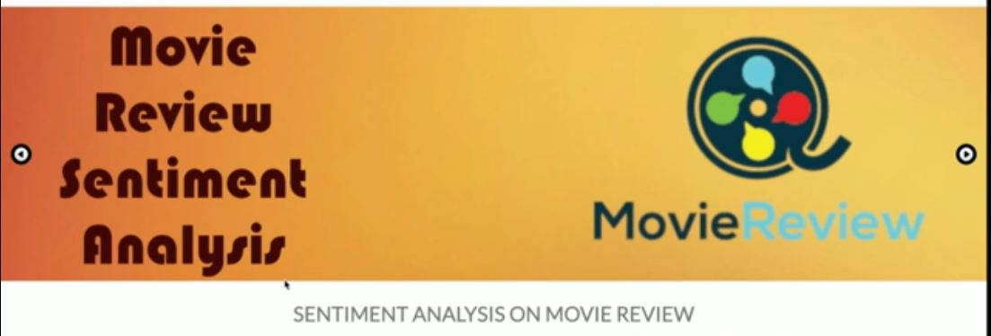
Problem Statement/Title - I
1. Intelligent System To Analyze Movie reviews.

Slide 4
Introduction
Aim:
To analyze movie reviews using sentiment analysis.
Purpose:
Rise of social media and social networking sites like book my show, IMDB, film.com for movie reviews
But manual reading of contents of reviews is a tedious and time consuming task for the movie viewers.
They are not able to make proper opinion/ judgments to watch movie or not.

Slide 5
Scope & Objectives
Scope:
System in English Languages only.
The system now analyzes this data to check for user sentiments associated with each comment and represent in graphical format.
Objectives:
To analyze movie viewers review and categorize review and also represented in graphical form.
To automatically rate the movie on the basis of reviews.
To develop Interactive GUI for Movie Review Analysis.

Slide 6
Tools
Front End
HTML Page layout has been designed in HTML
CSS has been used for all the designing part.
JavaScript: All the validation task and animations has been developed by JavaScript.
Project has been developed over the Flask Framework.
Python Library: Textblob, NLTK.
Database: SQLITE database.

Slide 7
Module Description
1. GUI - Web design
Home Page will contain an animated slider for images banner
About us page will be available which will describe about the project
User/admin Login.
Provide platform to user for posting reviews & to admin for adding movie description.

Slide 8
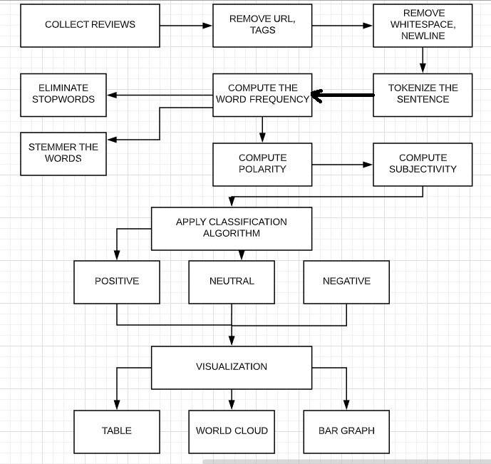
System Architecture

Slide 9
Module Description
2. How to Analyze customer review ?
2.1 Pre-Processing Phase:
To reduce noise, data has been cleaned up somewhat, for example:
1. The dataset is comprised of only English reviews.
2. All text has been converted to lowercase.
3. There is white space around punctuation like periods, commas, &
brackets.
4. Text has been split into one sentence per line.
5. Using an exhaustive stop word list, some words can be ignored and removed during the preprocessing.
6. Eliminating features with very poor frequency.

Slide 10
Module Description
2.2 Feature Extraction: A token is given to the keywords and this token is now put under analysis.
2.3 Classification Phase:
Classification is done for two classes: positive and negative. However, we can add more classes like neutral, highly positive, highly negative, etc. We use Textblob library is combination of NLTK & Google Translator which used for Classification (by using Naive Bayes, Decision Tree) & Tokenization (splitting text into words and sentences)

Slide 11
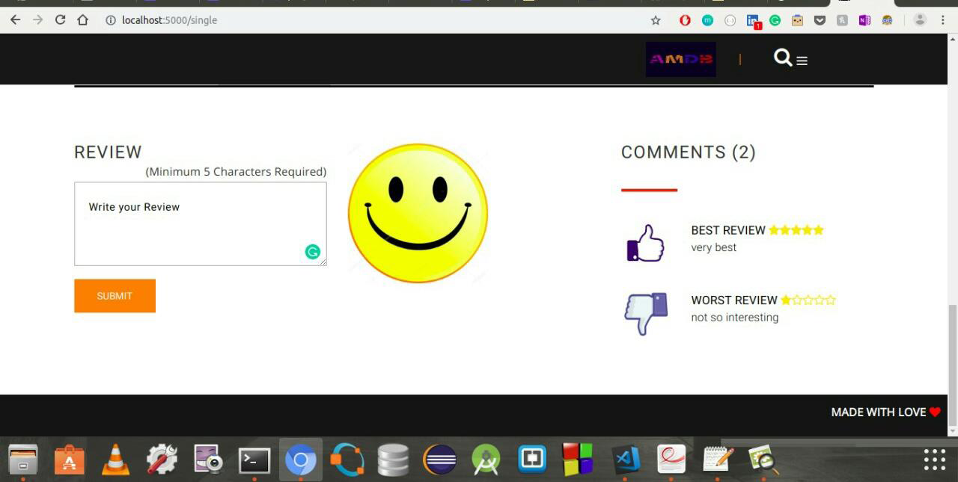
GUI

Slide 12
Problem Statement/Title - II
2. Text Summarization
Purpose:
Many of those applications are for the platform which publishes articles on daily news, entertainment, sports.
With our busy schedule, we prefer to read the summary of that article before we decide to jump in for reading entire article.
Reading a summary help us to identify the interest area, gives a brief context of the story.
Summarization can be defined as a task of producing a concise and fluent summary while preserving key information and overall meaning.

Slide 13
Module Description
How text summarization works?
1. Abstractive Summarization:
Input document → understand context → semantics → create own summary.
2. Extractive Summarization:
Input document → sentences similarity → weight sentences → select sentences with higher rank.

Slide 14
Summarization Libraries Step
Remove stop words for the analysis
Create frequency table of words - how many times each word appears in the text
Assign score to each sentence depending on the words it contains and the frequency table
Build summary by adding every sentence above a certain score threshold.
NLTK & SpaCy working same
Sumy – Sentence frequently matching
Gensim – Text Rank Algorithm

Slide 15
Module Description
TextRank is an extractive and unsupervised text summarization technique.

Slide 16
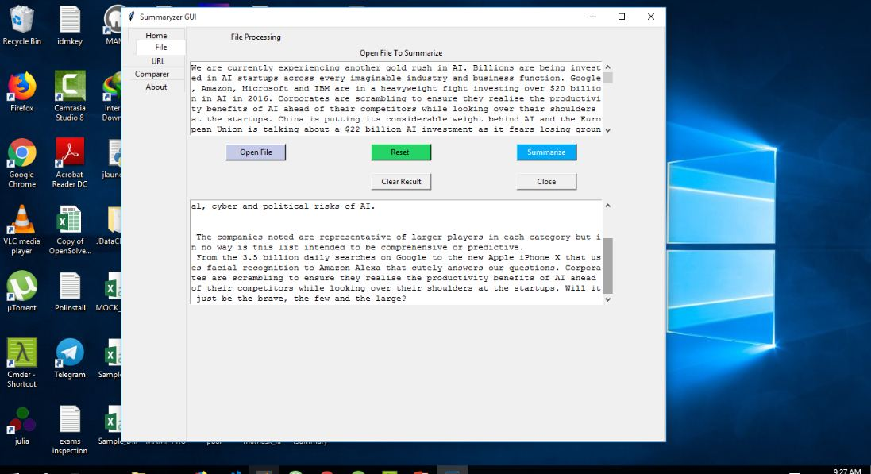
GUI

Slide 17
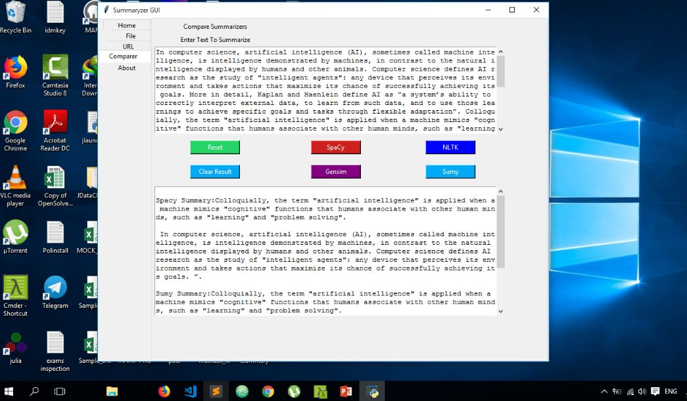
GUI

Slide 18
Other Mini Projects
Raspberry Pi –
Reverse Parking of car.
Automatic shutter closing of green house.
Image Processing –
Object Identification and convert into audio for blind people
Paragraph Identification in scanned documents.
ML – Song Recommendation System.
C++.
R.
Angular.

Slide 19
Web Links
Github - https://github.com/NiranjanVpatil
LinkedIn - https://www.linkedin.com/in/niranjan-patil-50223214a/
Codechef - https://www.codechef.com/users/niranjanpatil
Twitter - https://twitter.com/Niranja34252588
Youtube - https://www.youtube.com/channel/UCgugtHyzl3RxiZoIUzlC19A

Slide 20
THANK YOU

